Slide 1
IMDB Movie Analysis
(Project – 5)
- BY HITISHA SONI

Slide 2
Project Description :-
Problem Statement: The dataset provided is related to IMDB Movies.
A potential problem to investigate could be: "What factors influence the success of a movie on IMDB?" Here, success can be defined by high IMDB ratings.
The impact of this problem is significant for movie producers, directors, and investors who want to understand what makes a movie successful to make informed decisions in their future projects.

Slide 3
Approach :-
We have given a dataset of movies.
Firstly, I have cleaned the whole dataset to get valuable insights.
Data Cleaning involves preprocessing the data to make it suitable for analysis. It includes handling missing values, removing duplicates, converting data types if necessary, and possibly feature engineering. So,
In total, there are 5044 rows (including headers)
There are 45 duplicate values.
And after cleaning and removing errors and blank cells in final clean dataset:
There are 3724 rows (including headers)

Slide 4
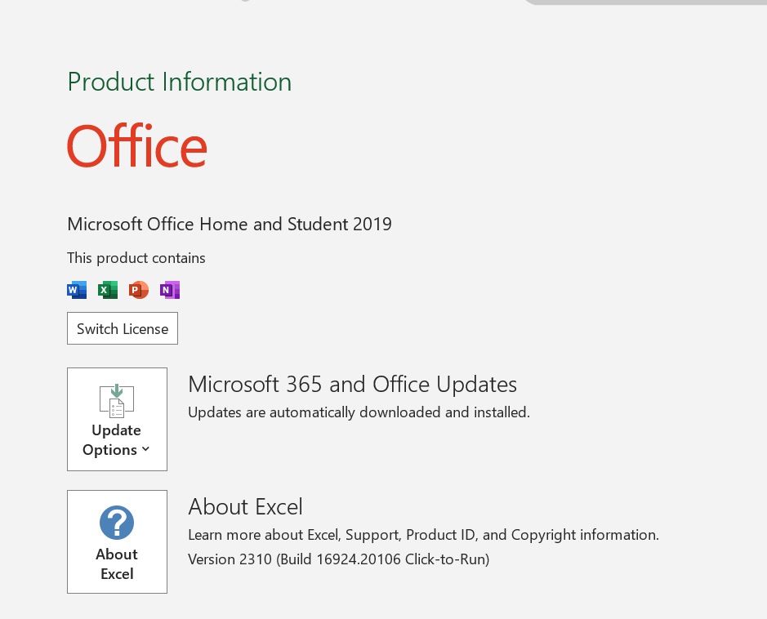
Tech-Stack Used:-

Slide 5
Tasks:
Link to excel file

Slide 6
A. Movie Genre Analysis: Analyze the distribution of movie genres and their impact on the IMDB score.
Task: Determine the most common genres of movies in the dataset. Then, for each genre, calculate descriptive statistics (mean, median, mode, range, variance, standard deviation) of the IMDB scores.

Slide 7
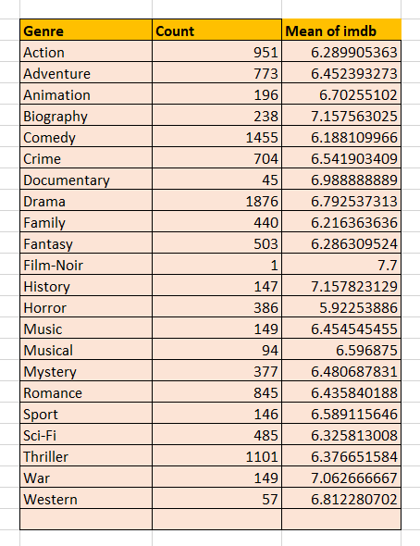
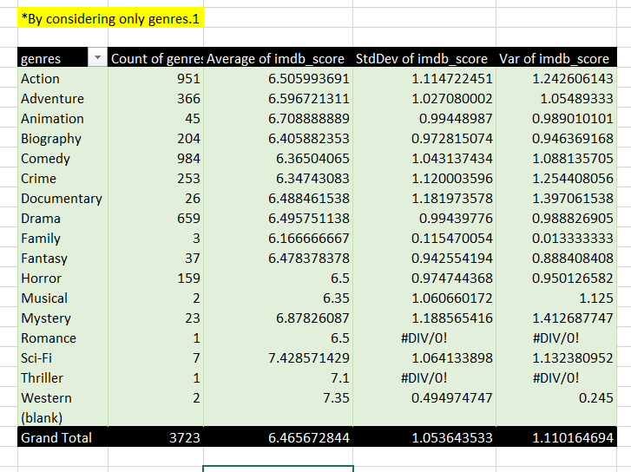
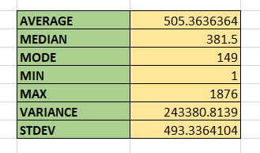

Slide 8
B. Movie Duration Analysis: Analyze the distribution of movie durations and its impact on the IMDB score.
Task: Analyze the distribution of movie durations and identify the relationship between movie duration and IMDB score.

Slide 9
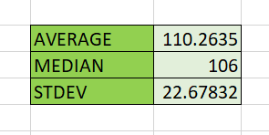

Slide 10
C. Language Analysis: Situation: Examine the distribution of movies based on their language.
Task: Determine the most common languages used in movies and analyze their impact on the IMDB score using descriptive statistics.

Slide 11
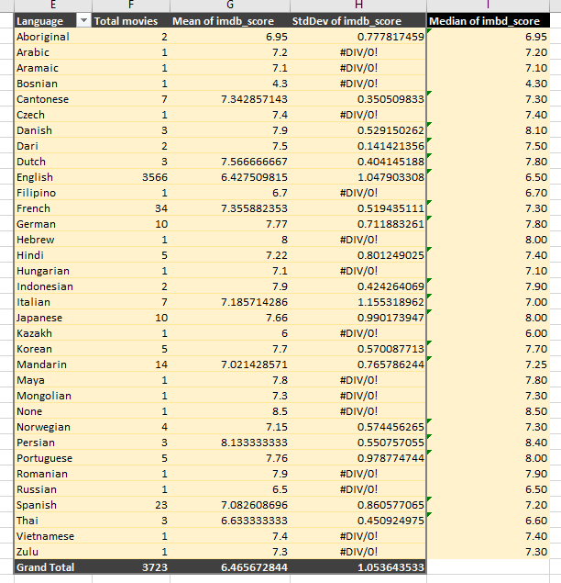

Slide 13
D. Director Analysis: Influence of directors on movie ratings.
Task: Identify the top directors based on their average IMDB score and analyze their contribution to the success of movies using percentile calculations.

Slide 14
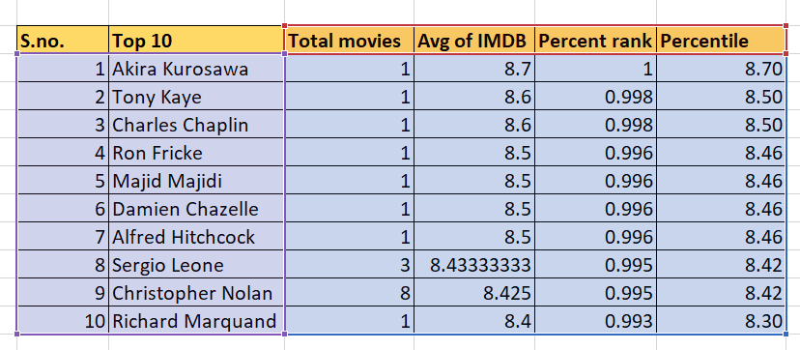

Slide 15
E. Budget Analysis: Explore the relationship between movie budgets and their financial success.
Task: Analyze the correlation between movie budgets and gross earnings, and identify the movies with the highest profit margin.

Slide 16
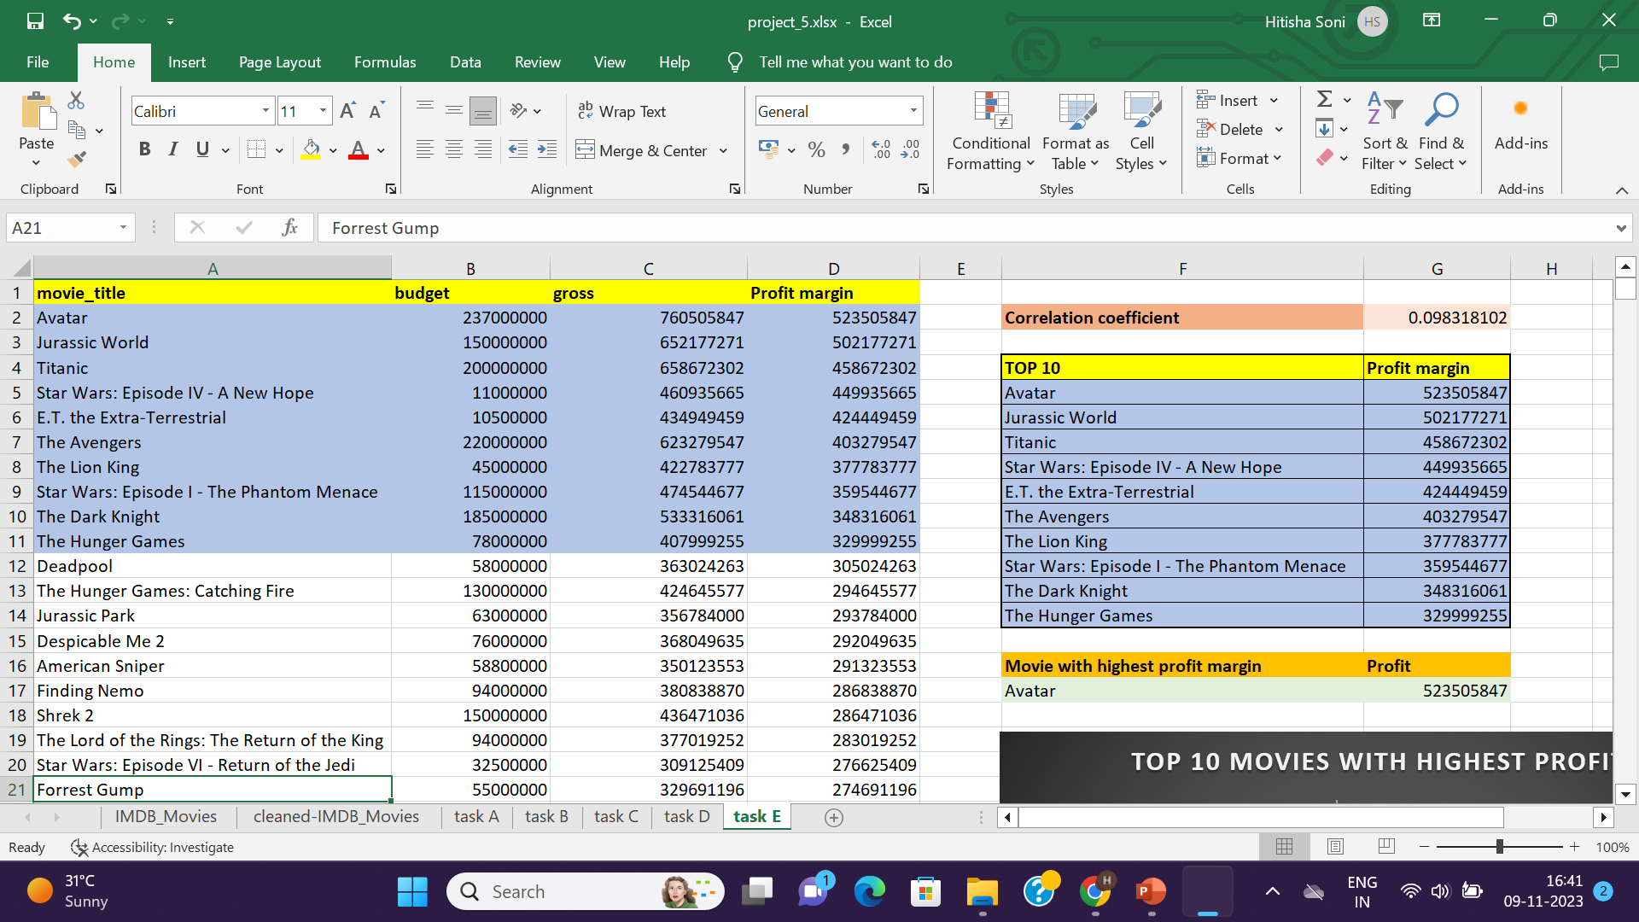

Slide 17
Insights & Results :-
The top most common genres are Drama, Comedy and Thriller, respectively with average IMDB of more than 6.0
If movie duration is more than 75 then there is a chance of getting more imdb_score, people often prefer to watch longer movie because longer the movie, more drama will be there.
So, movies with more than 100 duration will have more ratings.
The most common language used in movies is English, second most is French and then Spanish.
The director with highest average imdb_score is Akira Kurosawa for the movie Seven Samurai.
The director who have made movies on popular genres has more average imdb_score.
Avatar is the movie with highest profit margin of 523505847 .

Slide 18
Thank You

